Slide 1

Computer Networks (CET2005B)
School of Computer Engineering and Technology (SCET)

Slide 2

Syllabus
4 | Transport Layer (9 Hrs) Services, Multiplexing, demultiplexing. Sockets, UDP, RTP, TCP: Services, Features, Segment, TCP Connection (Three-Way Handshake), Flow control and buffering, Silly window syndrome, Congestion Control. Congestion Control (Leaky Bucket, Token Bucket), Quality of Service (QoS)

Slide 3
Transport Layer: Contents
Services
Multiplexing, Demultiplexing.
Sockets
UDP (User Datagram Protocol ), RTP (Real-Time Transport Protocol), TCP (The Transmission Control Protocol): Services, Features, Segment
TCP Connection (Three-Way Handshake)
Flow Control and buffering (Sliding Window)
Flow and Congestion Control (Leaky Bucket, Token Bucket)
Quality of Service (QoS)

Slide 4
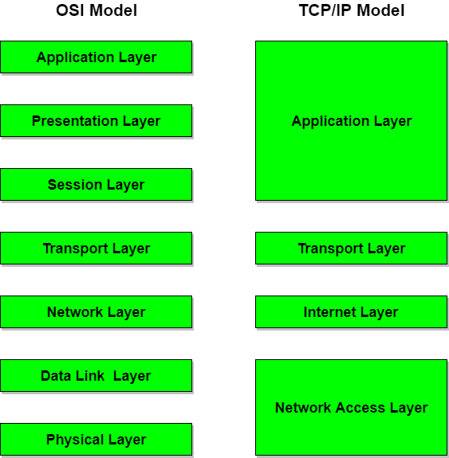
Introduction
The transport layer in the TCP/IP suite is located between the application layer and the network layer.
It provides services to the application layer and receives services from the network layer.
The transport layer acts as a liaison between a client program and a server program, a Process-to-Process connection.
The transport layer is the heart of the TCP/IP protocol suite.

Slide 5
Transport Layer Services
At the sender’s side: The transport layer receives data (message) from the Application layer and then performs Segmentation, divides the actual message into segments, adds the source and destination’s port numbers into the header of the segment, and transfers the message to the Network layer.
At the receiver’s side: The transport layer receives data from the Network layer, reassembles the segmented data, reads its header, identifies the port number, and forwards the message to the appropriate port in the Application layer.

Slide 6
Responsibilities of a Transport Layer
The Process to Process Delivery
End-to-End Connection between Hosts
Multiplexing and Demultiplexing
Congestion Control
Data integrity and Error correction
Reliable delivery
Flow control

Slide 7
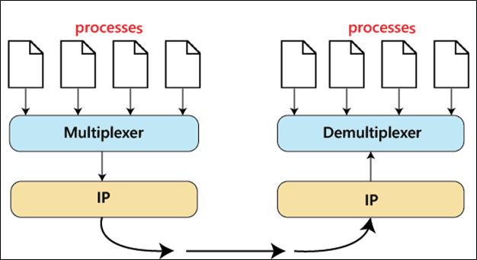
Responsibilities of a Transport Layer
The Process to Process Delivery:
Data Link Layer requires the MAC address, Network layer requires the IP address in a similar way Transport Layer requires a Port number to correctly deliver the segments of data to the correct process amongst the multiple processes running on a particular host.
A port number is a 16-bit address used to identify any client-server program uniquely.

Slide 8
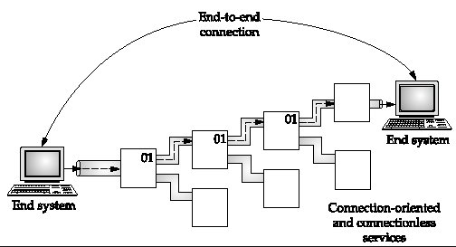
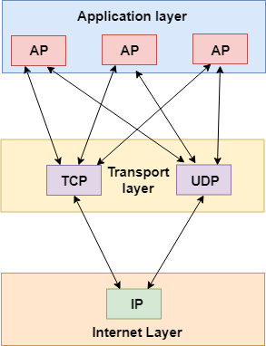
Responsibilities of a Transport Layer
End-to-end Connection between Hosts:
The transport layer is also responsible for creating the end-to-end Connection between hosts for which it mainly uses TCP and UDP.

Slide 9
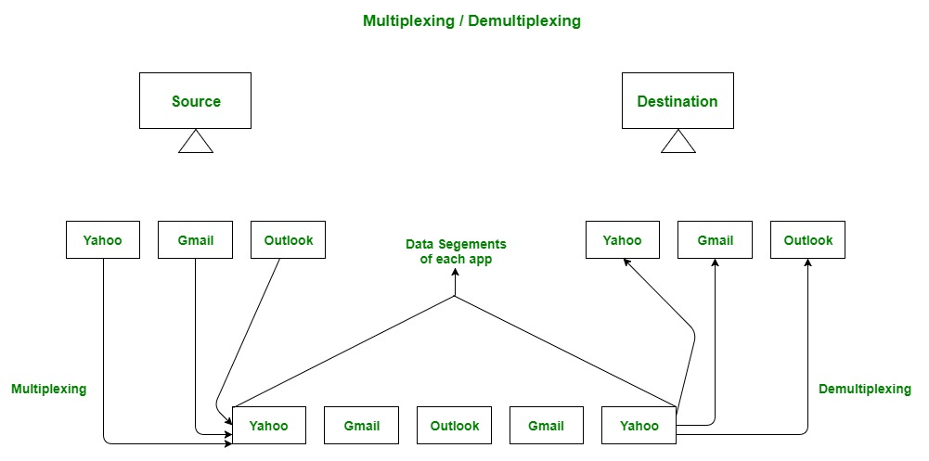
Responsibilities of a Transport Layer
Multiplexing and Demultiplexing:
Multiplexing allows the simultaneous use of different processes over a network that is running on a host. Data is acquired from several processes from the sender and merged into one packet along with headers and sent as a single packet. The processes are differentiated by their port numbers.
Demultiplexing is required at the receiver side when the message is distributed into different processes. Transport receives the segments of data from the network layer distributes and delivers it to the appropriate process running on the receiver’s machine.

Slide 10
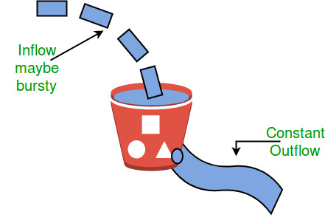
Responsibilities of a Transport Layer
Congestion Control:
Transport layer provides Congestion Control in different ways.
It uses open-loop congestion control to prevent congestion and closed-loop congestion control to remove the congestion in a network once it occurred.
Leaky Bucket Congestion Control Technique

Slide 11
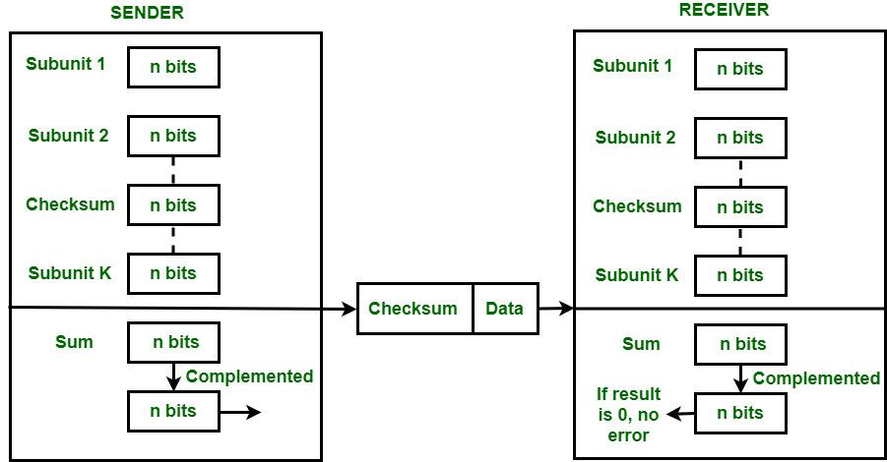
Responsibilities of a Transport Layer
Data integrity and Error Correction: The transport layer checks for errors in the messages coming from the application layer by using error detection codes, and computing checksums.
It uses the ACK and NACK services to inform the sender if the data has arrived or not and checks for the integrity of data.

Slide 12
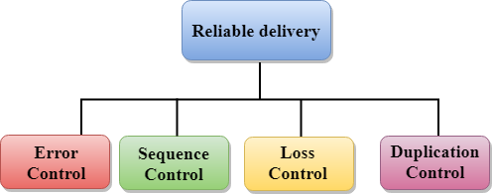
Responsibilities of a Transport Layer
Reliable delivery:
The transport layer provides reliability services by retransmitting the lost and damaged packets.
Error Control: If an error is introduced inside one of the routers, then this error will not be caught by the data link layer. The transport layer performs the checking for the errors end-to-end to ensure that the packet has arrived correctly.
Sequence Control: On the receiving end, it ensures that the various segments of a transmission can be correctly reassembled.
Duplication Control: The transport layer guarantees that no duplicate data arrive at the destination. Sequence numbers allow the receiver to identify and discard duplicate segments.
Loss Control: The transport layer ensures that all the fragments of a transmission arrive at the destination using the segment numbers given at the sender side

Slide 13
Responsibilities of a Transport Layer
Flow Control:
The transport layer provides a flow control mechanism between the adjacent layers of the TCP/IP model.
TCP also prevents data loss due to a fast sender and slow receiver by imposing some flow control techniques.
It uses the method of sliding window protocol which is accomplished by the receiver by sending a window back to the sender informing the size of data it can receive.
Sliding window protocol is byte oriented rather than frame oriented.

Slide 14
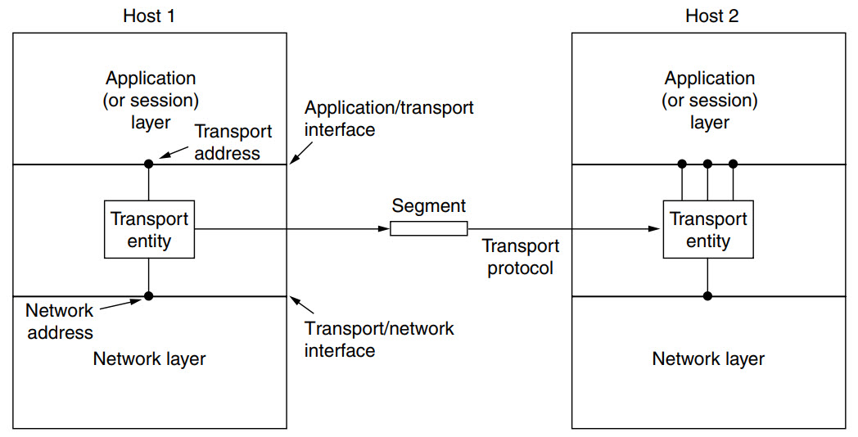
Transport Primitives
Transport entity -
The (logical) relationship of the network, transport, and application layers
On the sending side, the transport layer converts the application-layer messages it receives from a sending application process into transport-layer packets, known as transport-layer segments in Internet terminology.

Slide 15
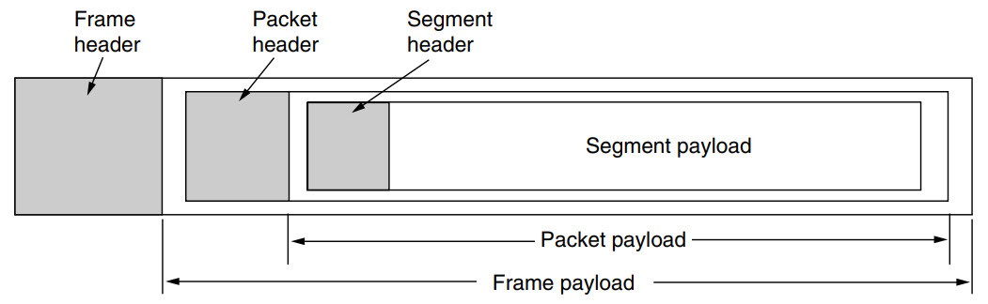
Transport Primitives
a segments.
a transport-layer header.
a network-layer packet (a datagram).

Slide 16
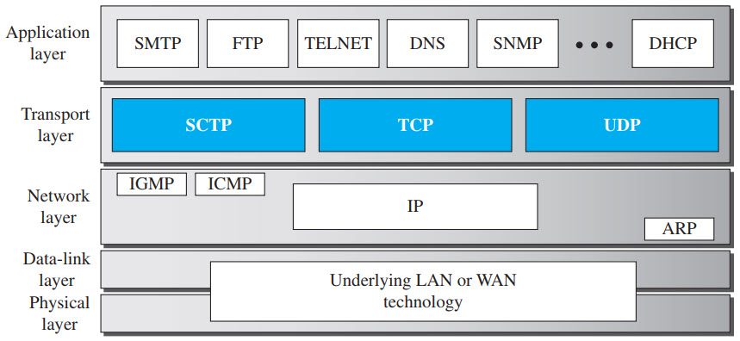
Transport Primitives
Transport Protocols –
Internet Protocol (IP) provides a packet delivery service across the internet
IP cannot distinguish between multiple processes (applications) running on the same computer
Fields in the IP datagram header identify only computers.
A protocol that allows an application to serve as an end-point of communication is known as a transport protocol or an end-to-end protocol.
The TCP/IP protocol suite provides transport protocols:
The User Datagram Protocol (UDP)
The Transmission Control Protocol (TCP)
Stream Control Transmission Protocol(SCTP)

Slide 17
Transport Primitives
Transport Protocols Services –
Each protocol provides a different type of service and should be used appropriately.
UDP:
UDP is an unreliable connectionless transport-layer protocol used for its simplicity and efficiency in applications where error control can be provided by the application-layer process.
TCP:
TCP is a reliable connection-oriented protocol that can be used in any application where reliability is important.
SCTP:
Stream Control Transmission Protocol is a connection-oriented network protocol to transmit multiple data streams between endpoints.

Slide 18
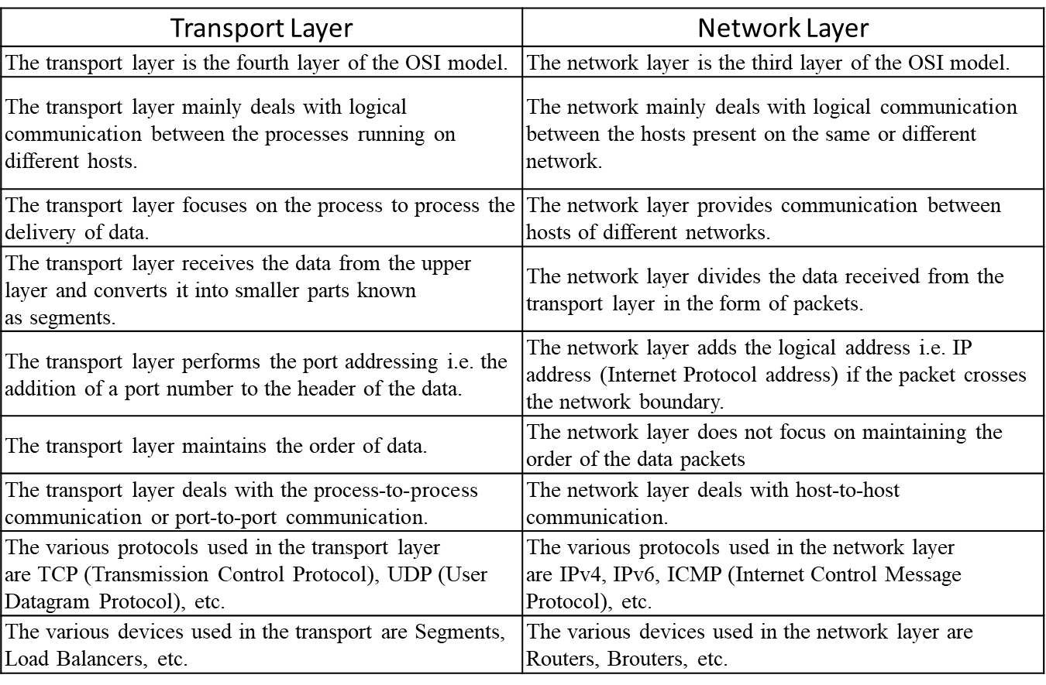

Slide 19
Client Server Architecture
There are several ways to achieve Process-to-Process communication, the most common one is through the Client/Server paradigm.
A process on the local host, called a client, needs services from a process usually on the remote host, called a server.
Both processes (client and server) have the same name. For example, to get the day and time from a remote machine, we need a Daytime client process running on the local host and a Daytime server process running on a remote machine.
A remote computer can run several server programs at the same time, just as local computers can run one or more client programs at the same time.

Slide 20
Port Numbers
A port number is a way to identify a specific process to which an internet or other network message is to be forwarded when it arrives at a server.
All network-connected devices come equipped with standardized ports that have an assigned number.
These numbers are reserved for certain protocols and their associated function.
Hypertext Transfer Protocol (HTTP) messages, for example, always go to port 80 -- one of the most commonly used ports.
An IP address is a logical address used to identify a device on the network. Any device connected to the internet is assigned a unique IP address for identification. This identifying information enables devices to communicate over the internet.
Port numbers are part of the addressing information that helps identify senders and receivers of information and a particular application on the devices. Port numbers consist of 16-bit numbers.

Slide 21
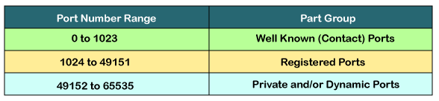
Port Numbers
A port number uses 16 bits and so can therefore have a value from 0 to 65535 decimal.
The lANA (Internet Assigned Number Authority) has divided the port numbers into three ranges: well known, registered, and dynamic (or private).
Port numbers 0-1023 – Well known Ports – e.g. Web servers normally use port 80 and SMTP servers use port 25
Ports 1024-49151 – Registered Port.
Ports 49152-65535 – Dynamic Ports – These are used by client programs.

Slide 22
Port Numbers
Some commonly used ports and their associated networking protocols:
Ports 20 and 21: FTP is used to transfer files between a client and a server.
Port 22: Secure Shell is one of several tunneling protocols used to build secure network connections.
Port 25: Simple Mail Transfer Protocol (SMTP) is commonly used for email.
Port 53: Domain name system (DNS) is a critical process that matches human-readable domain names to machine-readable IP addresses on the modern internet. It helps users load websites and applications without typing in a long list of IP addresses.
Port 80: HTTP is the protocol that enables the World Wide Web.
Port 123: Network Time Protocol helps computer clocks sync with each other. It's a vital process in encryption
Port 179: Border Gateway Protocol (BGP) helps establish efficient routes between the large networks or autonomous systems that make up the internet. These large networks use BGP to broadcast which IP addresses they control.

Slide 23
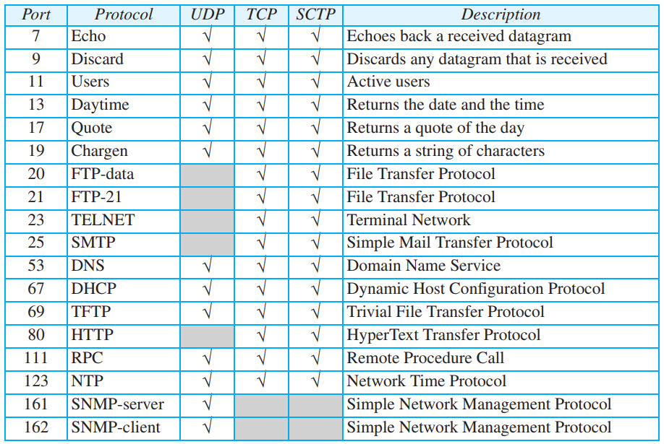
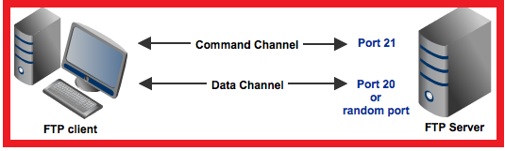
Some Common Port Numbers
Figure: Some well-known ports used with UDP and TCP

Slide 24
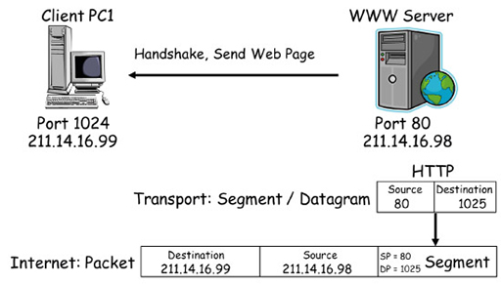
Port Numbers

Slide 25
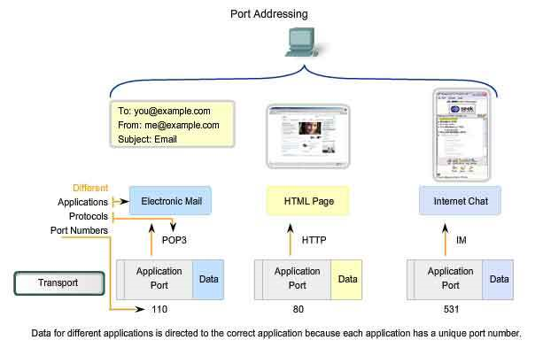
Port Numbers (Cntd.)
Post Office Protocol
Hyper Text Transfer Protocol.

Slide 26
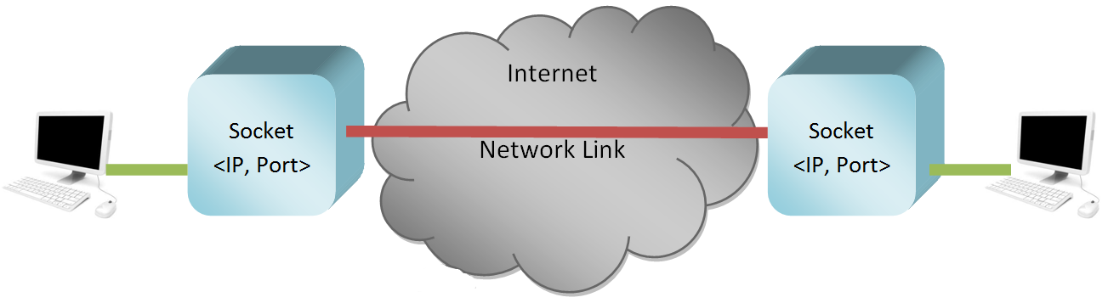
Sockets
A process sends messages into, and receives messages from, the network through a software interface called a Socket.
A socket is one endpoint of a two way communication link between two programs running on the network.
Figure illustrates socket communication between two processes that communicate over the Internet.

Slide 27
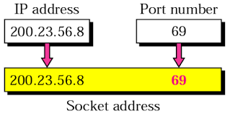
Sockets
The socket provides bidirectional FIFO Communication facility over the network
Socket are generally employed in client server applications.
The server creates a socket, attaches it to a network port addresses then waits for the client to contact it.
The client creates a socket and then attempts to connect to the server socket. When the connection is established, transfer of data takes place.
Each socket has a specific address. This address is composed of an IP address and a port number.

Slide 28
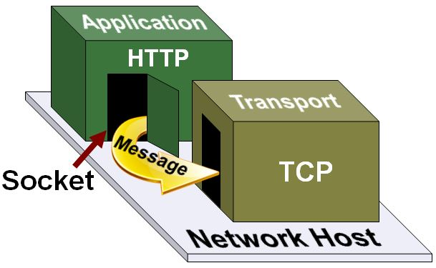
Sockets
A socket is a software concept for a connection.
Sockets enable applications to connect to transport layer protocol (TCP/IP / UDP / SCTP).
An application running on a host creates a socket to connect with an application on another host.
Messages pass through this socket.

Slide 29
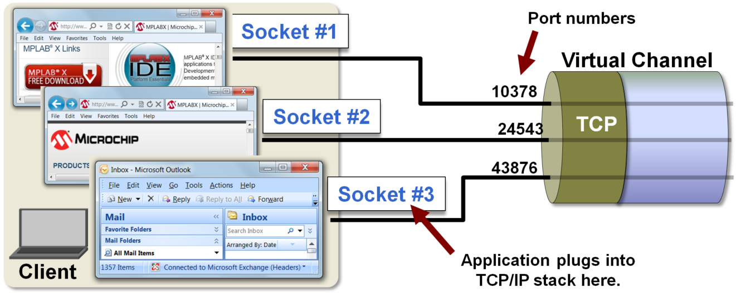
Sockets (Cntd.)
Three applications requiring three TCP communication channels:
Two channels for each of the two web browsers acting as HTTP clients, and one for the email application acting as an SMTP client.

Slide 30
Types of Sockets (Cntd.)
Datagram Sockets:
Datagram Sockets are connectionless-oriented and unreliable.
Uses UDP (User Datagram Protocol) protocol.
They are basically used in audio/video streaming.
Stream Sockets:
Stream Sockets are connection-oriented and guarantees reliable and in order data transmission.
Uses TCP (Transmission Control Protocol) protocol.
Used in areas where reliability cannot be compromised.

Slide 31
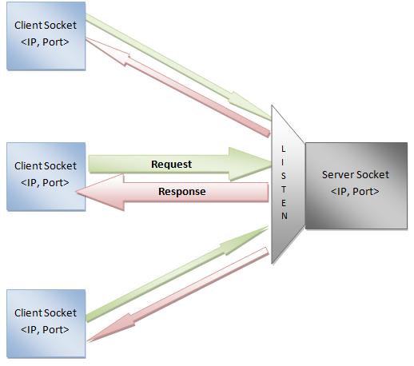
Client Server Model Example
Client/Server Model
Sockets as we know are used in bidirectional network communication and a good example of it is client/server model.
Client: Client is a machine which generates the requests.
Server: Server is a machine which is generates a response to the corresponding requests.
It is always listening for requests.
Consider an example, a website
A website is hosted on a machine (server) which listens
continuously for HTTP requests.
All the webpages are stored in the server.
Users who log into the website are actually clients which send
HTTP request to access a webpage.
An webpage is sent as a response to a request.

Slide 32
Connectionless and Connection Oriented Protocol
A transport-layer protocol, like a network-layer protocol, can provide two types of services: connectionless and connection-oriented.
The nature of these services at the transport layer, however, is different from the ones at the network layer.
At the network layer, a connectionless service may mean different paths for different datagrams belonging to the same message; connection-oriented means dedicated path established before communication initiated.
At the transport layer, we are not concerned about the physical paths of packets
Connectionless service at the transport layer means independency between packets
Connection-oriented service at the transport layer means dependency between packets
The connectionless protocol is UDP.
The connection-oriented protocol is TCP.

Slide 33
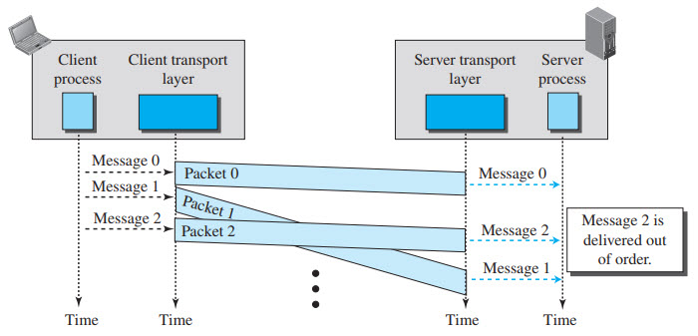
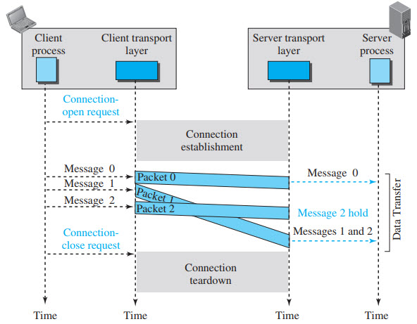
Connectionless and Connection Oriented Protocol
Connectionless Service: independency between packets
Connection-oriented Service: Dependency between packets

Slide 34
Transmission Control Protocol [TCP]
Transmission Control Protocol (TCP) is a connection-oriented, reliable protocol.
Connection-Oriented Service – explicitly defines connection establishment, data transfer, and connection teardown (Closing/ Releasing) phases.
TCP Applications:
Useful for applications that require reliable data delivery, and can tolerate some timing variation
File transfer and web downloads
Email
Instant messaging

Slide 35
TCP Services
Process-to-Process Communication
Stream oriented
Full-duplex service
Connection-oriented service
Reliability
Multiplexing

Slide 36
TCP Services
Process to process communication – TCP provides a process to process communication, i.e, the transfer of data that takes place between individual processes executing on end systems. This is done using socket address
Stream oriented – the data is sent and received as a stream of bytes. TCP groups a number of bytes together into a segment and adds a header to each of these segments and then delivers these segments to the network layer.
At the network layer, each of these segments is encapsulated in an IP packet for transmission. The TCP header has information that is required for control purposes which will be discussed along with the segment structure.
Full-duplex service – This means that the communication can take place in both directions at the same time.

Slide 37
TCP Services
Connection-oriented service – TCP provides a connection-oriented service. It defines 3 different phases:
Connection establishment
Data transfer
Connection termination
Reliability – TCP is reliable as it uses checksum for error detection, attempts to recover lost or corrupted packets by re-transmission, acknowledgement policy and timers. It uses features like byte number and sequence number and acknowledgement number so as to ensure reliability. Also, it uses congestion control mechanisms.
Multiplexing – TCP does multiplexing and de-multiplexing at the sender and receiver ends respectively as a number of logical connections can be established between port numbers over a physical connection.

Slide 38
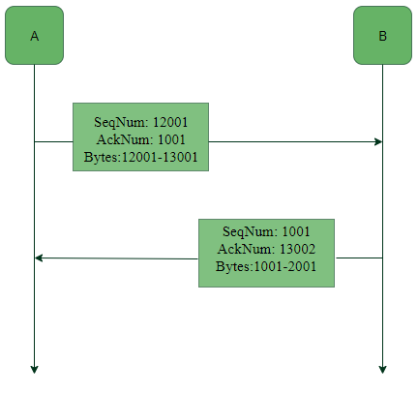
TCP Services
Byte number, Sequence number and Acknowledgement number
All the data bytes that are to be transmitted are numbered
Sequence numbers are given to the segments so as to reassemble the bytes at the receiver end
The sequence number of a segment is the byte number of the first byte that is being sent.
The acknowledgement number is the next byte number that the receiver expects to receive.

Slide 39
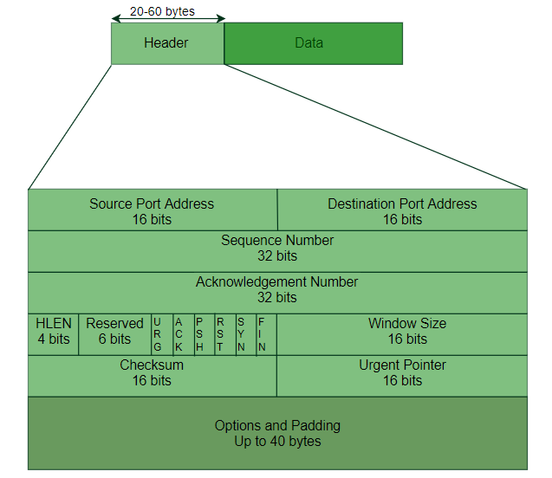
TCP Segment format

Slide 40
TCP Header
Source Port (16-bits): It identifies source port of the application process on the sending device.
Destination Port (16-bits): It identifies destination port of the application process on the receiving device.
Sequence Number (32-bits): Sequence number of data bytes of a segment in a session.
Acknowledgement Number (32-bits): When ACK flag is set, this number contains the next sequence number of the data byte expected and works as acknowledgement of the previous data received.
Header Length (HLEN): This is a 4-bit field that indicates the length of the TCP header. The number stored is multiplied by 4 to get the length in bytes (e.g. field will hold 5 then length is 5 x 4 = 20)

Slide 41
TCP Header
Window size: This field tells the window size of the sending TCP in bytes.
Checksum: This field holds the checksum for error control.
Urgent pointer: This field (valid only if the URG control flag is set) is used to point to data that is urgently required that needs to reach the receiving process at the earliest.
Reserved (3-bits): Reserved for future use and all are set zero by default.
Control flags:
URG: Urgent pointer is valid
ACK: Acknowledgement number is valid( used in case of cumulative acknowledgement)
PSH: Request for push
RST: Reset the connection
SYN: Synchronize sequence numbers
FIN: Terminate the connection

Slide 42
TCP Header
Urgent (URG) –Data inside a segment with URG = 1 flag is forwarded to application layer immediately even if there are more data to be given to application layer.
Acknowledgement (ACK) –
It is used to acknowledge packets which are successfully received by the host. The flag is set if the acknowledgement number field contains a valid acknowledgement number.
Push (PSH) – Transport layer by default waits for some time for application layer to send enough data equal to maximum segment size.
Sender Transport layer sets PSH = 1 and immediately sends the segment to network layer as soon as it receives signal from application layer. Receiver transport layer, on seeing PSH = 1 immediately forwards the data to application layer.

Slide 43
TCP Header
Reset (RST):
It is used to terminate the connection if the sender feels something is wrong with the TCP connection or that the conversation should not exist.
Synchronization(SYN): It is used in first step of connection establishment phase. Only the first packet from sender as well as receiver should have this flag set. This is used for synchronizing sequence number
Finish (FIN) – It is used to request for connection termination i.e. when there is no more data from the sender, it requests for connection termination. This is the last packet sent by sender. It frees the reserved resources and gracefully terminate the connection.

Slide 44
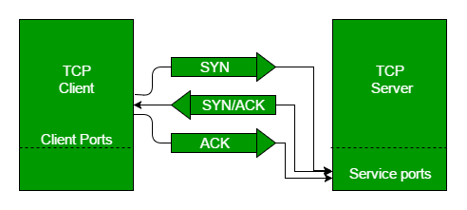
TCP: Connection Establishment
Connection Establishment: Three way Handshaking
A TCP connection is opened by a three-way handshake to establish a common view of the sequence numbers.

Slide 45
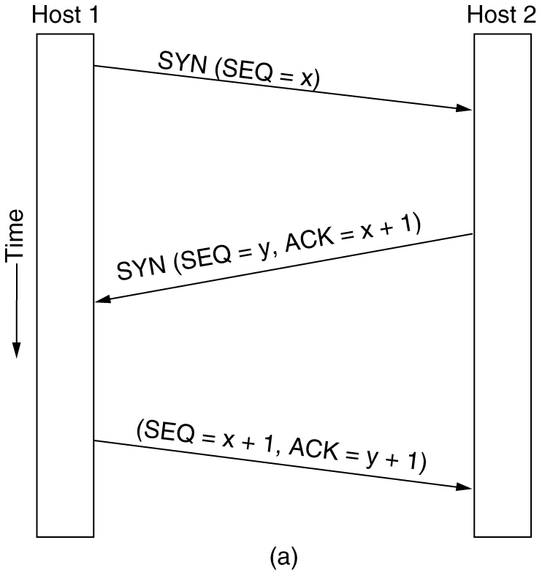
Transmission Control Protocol [TCP] (Cntd.)
1. Connection Establishment: Three way Handshaking
Host 1 chooses a sequence number, x, and sends a CONNECTION REQUEST segment containing it to host 2.
Host 2 replies with an ACK segment acknowledging x and announcing its own initial sequence number, y.
Finally, host 1 acknowledges host 2’s choice of an initial sequence number in the first data segment that it sends.

Slide 46
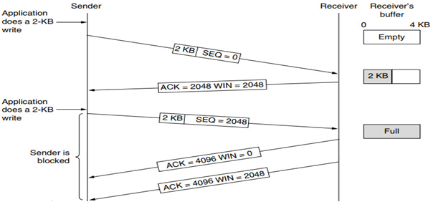
Windows in TCP
Windows in TCP: TCP uses two windows (send window and receive window) for each direction of data transfer
Senders send 2KB of data along with Seq no.
Receiver sends ACK of previous SEQ no and send remaining window size WIN (2048)
Sender again send 2KB of data to receiver.
Now at Receivers side buffer gets full, so he sends ACK of previous SEQ no and WIN =0. Sender is in blocked state until some memory of receiver's buffer is empty.
Receivers buffer is always full until it PUSH the data to application layer
This state is called Silly window syndrome problem

Slide 47
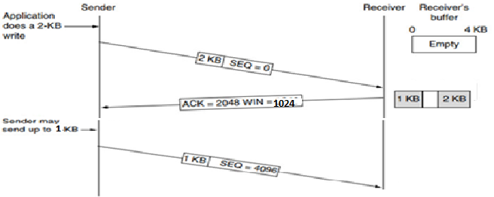
Windows in TCP
To resolve Silly Window Syndrome problem, receiver sends half of the remaining window size
As shown in dig. Instead of sending 2KB of free space receiver sends 1 KB as a window size
So receiver will always have 1Kb of remaining window size.
Application always read the data of 1KB (in this problem), so receiver will never have buffer full problem and sender will not be in block state.
This is called as Nagle’s algorithm.

Slide 48
Closing / Releasing of TCP Connection
TCP supports two types of connection releases like most connection-oriented transport protocols:
Graceful connection release – In the Graceful connection release, the connection is open until both parties have closed their sides of the connection.
Abrupt connection release – In an Abrupt connection release, either one TCP entity is forced to close the connection or one user closes both directions of data transfer.

Slide 49
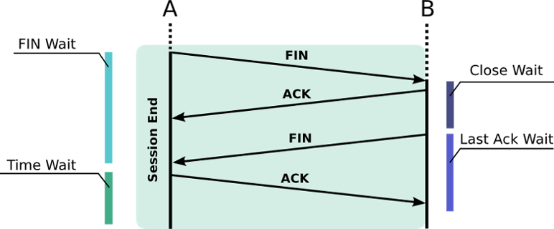
Closing / Releasing of TCP Connection
Graceful Connection Release :
The common way of terminating a TCP connection is by using the TCP header’s FIN flag.
A sends a FIN packet and waits for a response; it can release some resources but awaits the response of the other part (Fin Wait)
B receives the FIN packet and must release resources; it waits for a closing application level (Close Wait)
B can now send a FIN to A and then await its acknowledgement (Last Ack wait).
A can now fully close its job, but it must wait for network collision (Time Wait); it may have to send the final ACK another time.
B eventually receives the final ACK and destroys (kills) the connection.`

Slide 50
Closing / Releasing of TCP Connection
Abrupt connection release : An abrupt connection release is carried out when an RST segment is sent
An RST segment can be sent for the below reasons:
When a non-SYN segment is received for a non-existing TCP connection.
In an open connection, some TCP implementations send an RST segment when a segment with an invalid header is received which prevents attacks by closing the corresponding connection.
When some implementations need to close an existing TCP connection, they send an RST segment. They will close an existing TCP connection for the following reasons:
Lack of resources to support the connection
The remote host is now unreachable and has stopped responding.

Slide 51
User Datagram Protocol [UDP]
User Datagram Protocol (UDP) is a communications protocol for time-sensitive applications like gaming, playing videos, or Domain Name System (DNS) lookups.
UDP results in speedier communication because it does not spend time forming a firm connection with the destination before transferring the data. Eliminating this step results in faster data transfer speeds.
The process behind UDP is fairly simple.
A target computer is identified and the data packets, called “datagrams,” are sent to it.
There is nothing in place to indicate the order in which the packets should arrive.
There is also no process for checking if the datagrams reached the destination.
As a result, the data may get delivered, and it may not.
The order in which it arrives is not controlled, as it is in TCP, so the way the data appears at the final destination may be glitchy, out of order, or have blank spots.

Slide 52
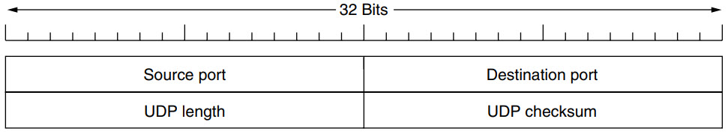
User Datagram Protocol [UDP]
Connectionless Transport Protocol.
UDP transmits segments consisting of an 8-byte fixed size header followed by the payload.
The header is shown below

Slide 53
User Datagram Protocol [UDP] (Cntd.)
Question: The following is the content of a UDP header in hexadecimal format.
CB84000D001C001C
What is the source port number?
What is the destination port number?
What is the total length of the user datagram?
What is the length of the data?
Is the packet directed from a client to a server or vice versa?
What is the client process?
Solution: Try to Solve It…….

Slide 54
User Datagram Protocol [UDP]
Solution
CB84000D001C001C
The source port number is the first four hexadecimal digits CB84H, which means that the source port number is 52100.
The destination port number is the second four hexadecimal digits 000DH, which means that the destination port number is 13.
The third four hexadecimal digits 001CH define the length of the whole UDP packet as 28 bytes.
The length of the data is the length of the whole packet minus the length of the header, or 28 − 8 = 20 bytes.
Since the destination port number is 13 (well-known port), the packet is from the client to the server.

Slide 55
User Datagram Protocol [UDP]
UDP Services:
Process to Process communication – using socket address
Connectionless services
Flow Control – Not present
Error Control – Not present
Checksum – based on pseudo header, UDP header, and data (Can be Optional)
Congestion Control – Not present
Encapsulation & Decapsulation
Queuing
Multiplexing & Demultiplexing

Slide 56
User Datagram Protocol [UDP]
UDP Applications:
UDP is suitable for a process that requires simple request-response
communication with little concern for flow and error control.
UDP is suitable for a process with internal flow- and error-control
mechanisms. For example, the Trivial File Transfer Protocol (TFTP).
UDP is a suitable transport protocol for multicasting.
UDP is used for management processes such as SNMP.
UDP is used for some route updating protocols such as Routing Information
Protocol (RIP).
UDP is normally used for interactive real-time applications that cannot
tolerate uneven delay between sections of a received message. E.g.
multimedia applications.
Client-server RPC is one area in which UDP is widely used.

Slide 57
Comparison of TCP and UDP
Basis | Transmission Control Protocol (TCP) | User Datagram Protocol (UDP)
Type of Service | TCP is a connection-oriented protocol. Connection orientation means that the communicating devices should establish a connection before transmitting data and should close the connection after transmitting the data. | UDP is the Datagram-oriented protocol. This is because there is no overhead for opening a connection, maintaining a connection, or terminating a connection. UDP is efficient for broadcast and multicast types of network transmission.
Reliability | TCP is reliable as it guarantees the delivery of data to the destination router. | The delivery of data to the destination cannot be guaranteed in UDP.
Error checking mechanism | TCP provides extensive error-checking mechanisms. It is because it provides flow control and acknowledgment of data. | UDP has only the basic error-checking mechanism using checksums.
Acknowledgment | An acknowledgment segment is present. | No acknowledgment segment.

Slide 58
Comparison of TCP and UDP
Basis | Transmission Control Protocol(TCP) | User Datagram Protocol (UDP)
Sequence | Sequencing of data is a feature of Transmission Control Protocol (TCP). this means that packets arrive in order at the receiver. | There is no sequencing of data in UDP. If the order is required, it has to be managed by the application layer.
Speed | TCP is comparatively slower than UDP. | UDP is faster, simpler, and more efficient than TCP.
Retransmission | Retransmission of lost packets is possible in TCP, but not in UDP. | There is no retransmission of lost packets in the User Datagram Protocol (UDP).
Header Length | TCP has a (20-60) bytes variable length header. | UDP has an 8 bytes fixed-length header.
Weight | TCP is heavy-weight. | UDP is lightweight.
Handshaking Techniques | Uses handshakes such as SYN, ACK, SYN-ACK | It’s a connectionless protocol i.e. No handshake

Slide 59
Comparison of TCP and UDP
Basis | Transmission Control Protocol (TCP) | User Datagram Protocol (UDP)
Broadcasting | TCP doesn’t support Broadcasting. | UDP supports Broadcasting.
Broadcasting | TCP doesn’t support Broadcasting. | UDP supports Broadcasting.
Protocols | TCP is used by HTTP, HTTPs, FTP, SMTP and Telnet. | UDP is used by DNS, DHCP, TFTP, SNMP, RIP, and VoIP.
Stream Type | The TCP connection is a byte stream. | UDP connection is a message stream.
Overhead | Low but higher than UDP. | Very low.
Applications | This protocol is primarily utilized in situations when a safe and trustworthy communication procedure is necessary, such as in email, on the web surfing, and in military services. | This protocol is used in situations where quick communication is necessary but where dependability is not a concern, such as VoIP, game streaming, video, and music streaming, etc.

Slide 60
Real-Time Transport Protocol [RTP]
Real-time Transport Protocol (RTP) is a network standard designed for transmitting audio or video data that is optimized for consistent delivery of live data.
It is used in internet telephony, Voice over IP and video telecommunication. It can be used for one-on-one calls (unicast) or in one-to-many conferences (multicast).
RTP must be used with UDP. It does not have any delivery mechanism like multicasting or port numbers.
RTP supports different formats of files like MPEG and MJPEG. It is very sensitive to packet delays and less sensitive to packet loss.

Slide 61
Real-Time Transport Protocol [RTP]
Multimedia Applications such as Internet radio, Internet telephony, music-on-demand, video conferencing, video-on-demand, and other are reinventing more or less the same real-time transport protocol.
Thus generic real-time transport protocol for multiple applications would be a good idea. i.e. RTP (Real-time Transport Protocol).
Aspects of real-time transport:
Transporting Audio and Video data in packets.
Processing that takes place, mostly at the receiver, to play out the audio and video at the right time.

Slide 62
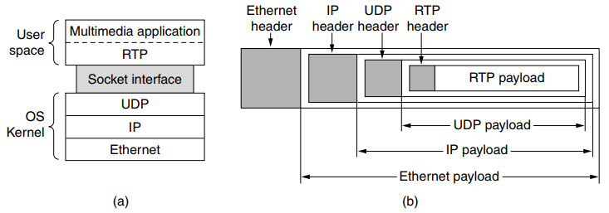
Real-Time Transport Protocol [RTP] (Cntd.)

Slide 63
Real-Time Transport Protocol [RTP] (Cntd.)
RTP normally runs in user space over UDP (in the operating system).
Its works as follows:
Multimedia
application
Fed into
RTP
library
Multiplexing
RTP
Packets
Through Sockets
UDP
Packets
IP
Packets
Ethernet
Because of this design, it is a little hard to say which layer RTP is in.
looks like an application protocol – because it runs in user space and is linked to the application program.
looks like a transport protocol – because it is a generic, application independent protocol that just provides transport facilities

Slide 64
Real-Time Transport Protocol [RTP] (Cntd.)
Basic function
Multiplex several real-time data streams onto a single stream of UDP packets.
Unicasting or Multicasting can be done.
There are no special guarantees about delivery, and packets may be lost, delayed, corrupted, etc.
The RTP format contains several features to help receivers work with multimedia information.
Sequence Numbering
Encoding for Different profiles such as audio, video etc.
Time stamping

Slide 65
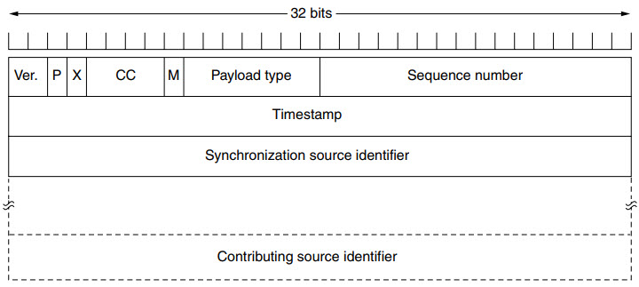
RTP Header

Slide 66
RTP Header
Version : This 2-bit field defines version number. The current version is 2
P – The length of this field is 1-bit. If value is 1, then it denotes presence of padding at end of packet and if value is 0, then there is no padding.
X – The length of this field is also 1-bit. If value of this field is set to 1, then its indicates an extra extension header between data and basic header and if value is 0 then, there is no extra extension.
Contributor count – This 4-bit field indicates number of contributors. Here maximum possible number of contributor is 15 as a 4-bit field can allows number form 0 to 15.
M – The length of this field is 1-bit and it is used as end marker by application to indicate end of its data.

Slide 67
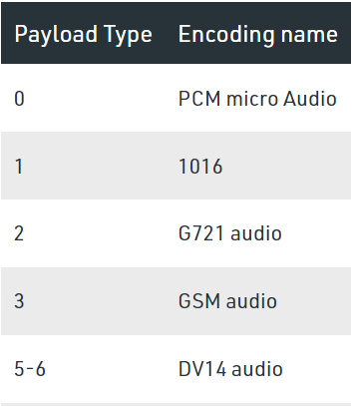
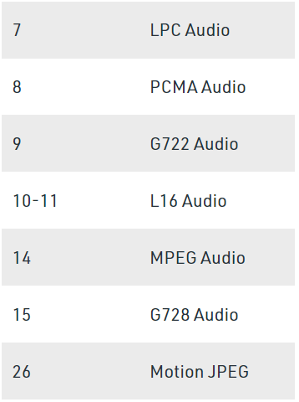
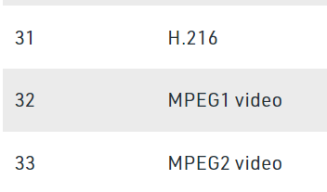
RTP Header
Payload types – This field is of length 7-bit to indicate type of payload. We list applications of some common types of payload.

Slide 68
Real-Time Transport Protocol [RTP] (Cntd.)
Time Stamp – The length of this field is 32-bit. It is used to find relationship between times of different RTP packets. The timestamp for first packet is given randomly and then time stamp for next packets given by sum of previous timestamp and time taken to produce first byte of current packet.
Sequence Number – The length of this field is 16 bits. It is used to give serial numbers to RTP packets. The sequence number for first packet is given a random number and then every next packet’s sequence number is incremented by 1. This field mainly helps in checking lost packets and order mismatch.

Slide 69
Real-Time Transport Protocol [RTP] (Cntd.)
Synchronization Source Identifier – This is a 32-bit field used to identify and define the source. The value for this source identifier is a random number that is chosen by source itself. This mainly helps in solving conflict arises when two sources started with the same sequencing number.
Contributor Identifier – This is also a 32-bit field used for source identification where there is more than one source present in session. The mixer source use Synchronization source identifier and other remaining sources (maximum 15) use Contributor identifier.

Slide 70
TCP: Error Control (Cntd.)
TCP is a reliable transport layer protocol. TCP provides reliability using error control.
Error control includes mechanisms for detecting----
Corrupted segments.
Lost segments.
Out-of-order segments.
Duplicated segments.
Error detection and correction tools: in TCP is achieved through the use of three simple tools:
Checksum.
Acknowledgment.
Time-out.

Slide 71
TCP: Error Control (Cntd.)
Checksum : Each segment includes a checksum field which is used to check for a corrupted segment. If the segment is corrupted, it is discarded by the destination TCP and is considered as lost. TCP uses a 16-bit checksum that is mandatory in every segment.
Acknowledgment : TCP uses acknowledgments to confirm the receipt of data segments. Control segments that carry no data but consume a sequence number are also acknowledged. ACK segments are never acknowledged.
Retransmission : The heart of the error control mechanism is the retransmission of segments. When a segment is corrupted, lost, or delayed, it is retransmitted.
In modern implementations, a segment is retransmitted on two occasions:
When a retransmission timer expires or
When the sender receives three duplicate ACKs.

Slide 72
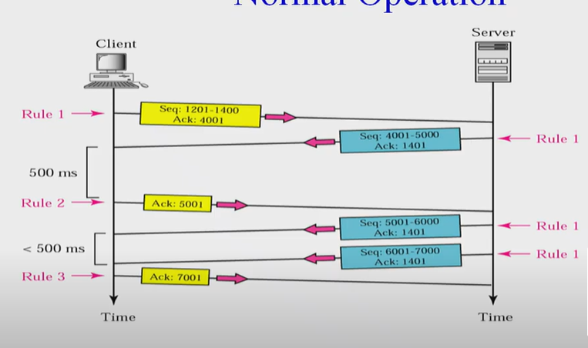
TCP: Error Control (Cntd.)
Error Control (Cntd.): Scenarios Normal operation

Slide 73
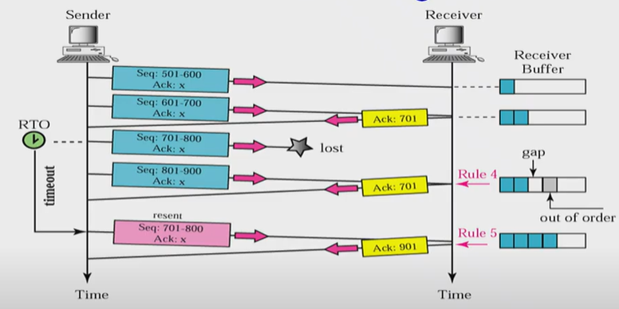
TCP: Error Control (Cntd.)
Retransmission (Cntd.)
Retransmission after retransmission time-out (RTO):
Sending TCP maintains one retransmission time-out (RTO) for each connection.
When the timer matures, i.e. times out, TCP resends the segment.
The value of RTO is dynamic in TCP and is updated based on the round-trip time (RTT) of segments.

Slide 74
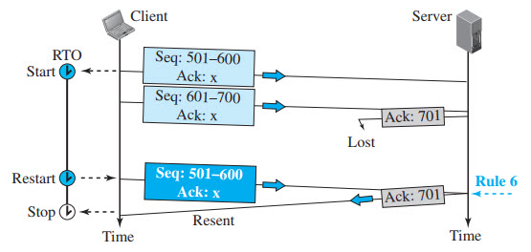
TCP: Error Control (Cntd.)
Retransmission (Cntd.)
Retransmission after retransmission time-out (RTO):
Lost acknowledgment corrected by resending a segment

Slide 75
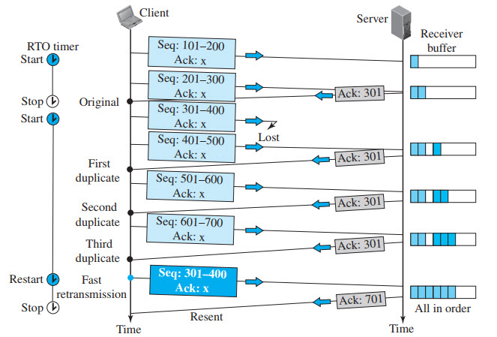
TCP: Error Control (Cntd.)
Retransmission after Three Duplicate ACK Segments:
Goal in this retransmission method is to allowing senders to retransmit without waiting for a time out.
if three duplicate acknowledgments (i.e., an original ACK plus three exactly identical copies) arrive for a segment, the next segment is retransmitted without waiting for the time-out.
This feature is called fast retransmission.

Slide 76
TCP: Error Control (Cntd.)
Error Control (Cntd.): Out of Order segments
Data may arrive out of order and be temporarily stored by the receiving TCP, but TCP guarantees that no out-of-order data are delivered to the process.

Slide 77
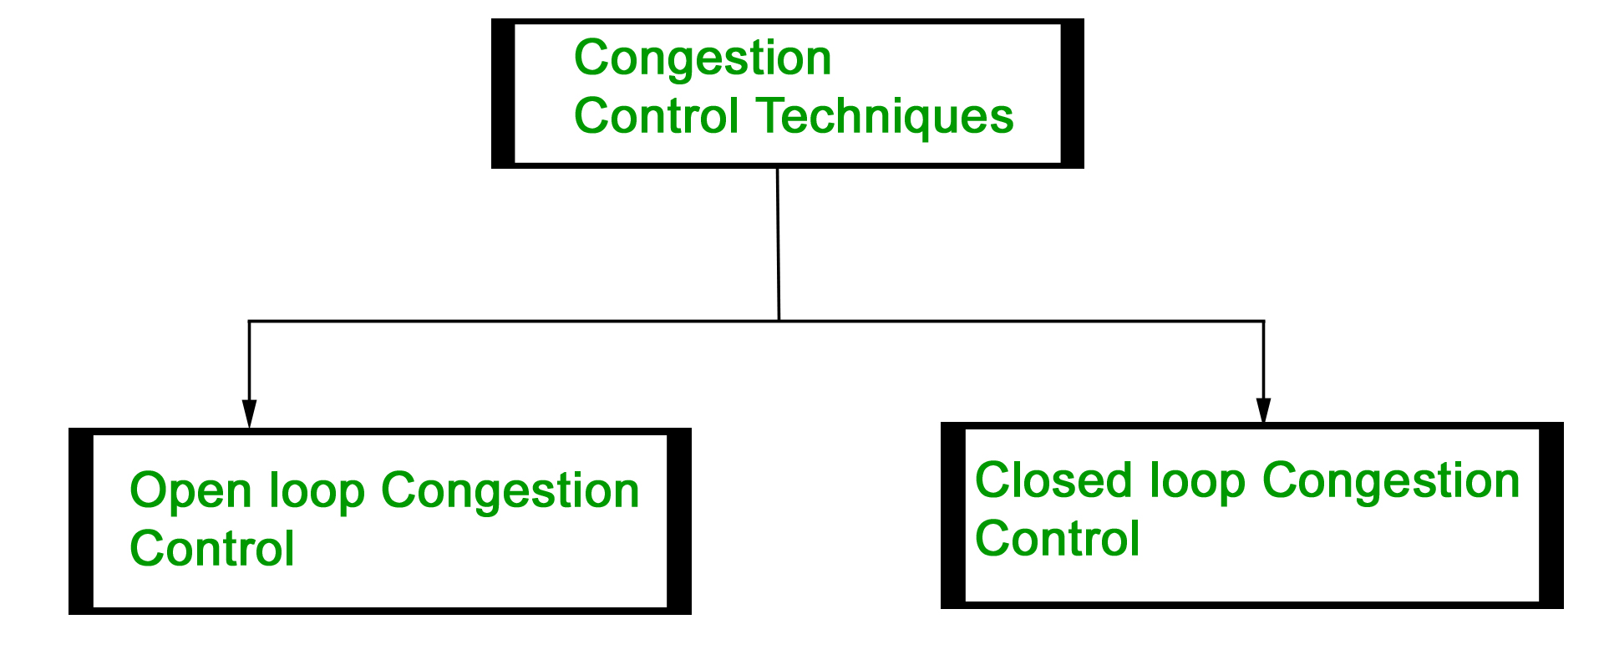
TCP: Congestion Control
Congestion control refers to Techniques and Mechanisms that can either Prevent congestion before it happens or Remove congestion after it has happened.
Prevention
Removal
Prevent congestion before it happens
Remove congestion after it has happened.

Slide 78
TCP: Congestion Control (Cntd.)
Congestion Control: Open-Loop Congestion Control (Prevention)
Open loop congestion control policies are applied to prevent congestion before it happens.
The congestion control is handled either by the source or the destination.
There is a brief list of policies that can prevent congestion.
Retransmission Policy
Window Policy
Acknowledgement Policy
Discarding Policy
Admission Policy (first check the resource requirement of a network flow before transmitting it further.)

Slide 79
TCP: Congestion Control (Cntd.)
Open-Loop Congestion Control Policies
Retransmission Policy : If the sender feels that a sent packet is lost or corrupted, the packet needs to be retransmitted.
This transmission may increase the congestion in the network. To prevent congestion, retransmission timers must be designed to prevent congestion and also able to optimize efficiency.
Window Policy : The type of window at the sender’s side may also affect the congestion. Several packets in the Go-back-n window are re-sent, although some packets may be received successfully at the receiver side.
This duplication may increase the congestion in the network and make it worse. Therefore, Selective repeat window should be adopted as it sends the specific packet that may have been lost.

Slide 80
TCP: Congestion Control (Cntd.)
Discarding Policy : A good discarding policy adopted by the routers is that the routers may prevent congestion and at the same time partially discard the corrupted or less sensitive packages and also be able to maintain the quality of a message.
In case of audio file transmission, routers can discard less sensitive packets to prevent congestion and also maintain the quality of the audio file.
Acknowledgment Policy : Since acknowledgements are also the part of the load in the network, the acknowledgment policy imposed by the receiver may also affect congestion. Several approaches can be used to prevent congestion related to acknowledgment.
The receiver should send acknowledgement for N packets rather than sending acknowledgement for a single packet. The receiver should send an acknowledgment only if it has to send a packet or a timer expires.

Slide 81
TCP: Congestion Control (Cntd.)
Admission Policy : In admission policy a mechanism should be used to prevent congestion. Switches in a flow should first check the resource requirement of a network flow before transmitting it further.
If there is a chance of a congestion or there is a congestion in the network, router should deny establishing a virtual network connection to prevent further congestion.

Slide 82
Transmission Control Protocol [TCP] (Cntd.)
Congestion Control: Closed-Loop Congestion Control (Removal)
Closed-loop congestion control mechanisms try to alleviate (lighten) congestion after it happens.
Several mechanisms have been used by different protocols. We describe a few of them here.
Backpressure.
Choke Packet.
Implicit Signaling.
Explicit Signaling.

Slide 83
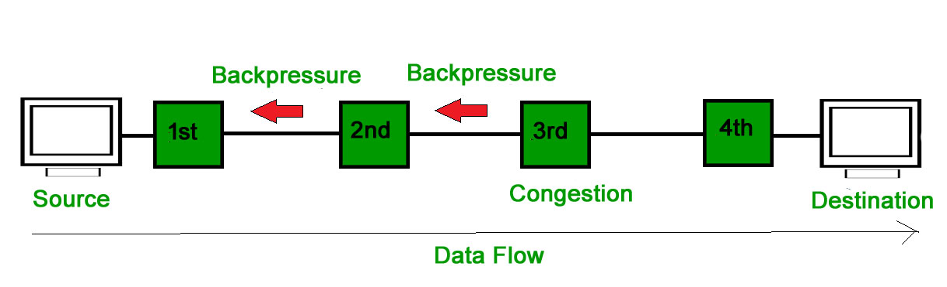
Transmission Control Protocol [TCP] (Cntd.)
Congestion Control: Closed-Loop Congestion Control (Removal) (Cntd.)
Backpressure :
Backpressure is a technique in which a congested node stops receiving packets from upstream node.
This may cause the upstream node or nodes to become congested and reject receiving data from above nodes.
Backpressure is a node-to-node congestion control technique that propagate in the opposite direction of data flow.
The backpressure technique can be applied only to virtual circuit where each node has information of its above upstream node.

Slide 84
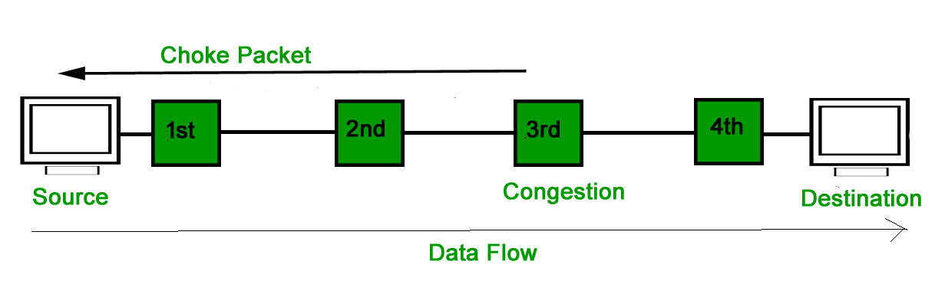
Transmission Control Protocol [TCP] (Cntd.)
Congestion Control: Closed-Loop Congestion Control (Removal) (Cntd.)
Choke Packet Technique :
Choke packet technique is applicable to both virtual networks as well as datagram subnets.
A choke packet is a packet sent by a node to the source to inform it of congestion.
Each router monitors its resources and the utilization at each of its output lines.
Whenever the resource utilization exceeds the threshold value which is set by the administrator, the router directly sends a choke packet to the source giving it a feedback to reduce the traffic.
The intermediate nodes through which the packets has traveled are not warned about congestion.

Slide 85
Transmission Control Protocol [TCP] (Cntd.)
Congestion Control: Closed-Loop Congestion Control (Removal) (Cntd.)
3. Implicit Signaling : In implicit signaling, there is no communication between the congested nodes and the source.
The source guesses that there is congestion in a network.
For example when sender sends several packets and there is no acknowledgment for a while, one assumption is that there is a congestion.

Slide 86
Transmission Control Protocol [TCP] (Cntd.)
Congestion Control: Closed-Loop Congestion Control (Removal) (Cntd.)
4. Explicit Signaling : In explicit signaling, if a node experiences congestion it can explicitly sends a packet to the source or destination to inform about congestion.
The difference between choke packet and explicit signaling is that the signal is included in the packets that carry data rather than creating a different packet as in case of choke packet technique.
Explicit signaling can occur in either forward or backward direction.
Forward Signaling : In forward signaling, a signal is sent in the direction of the congestion. The destination is warned about congestion. The receiver in this case adopt policies to prevent further congestion.
Backward Signaling : In backward signaling, a signal is sent in the opposite direction of the congestion. The source is warned about congestion and it needs to slow down.

Slide 87
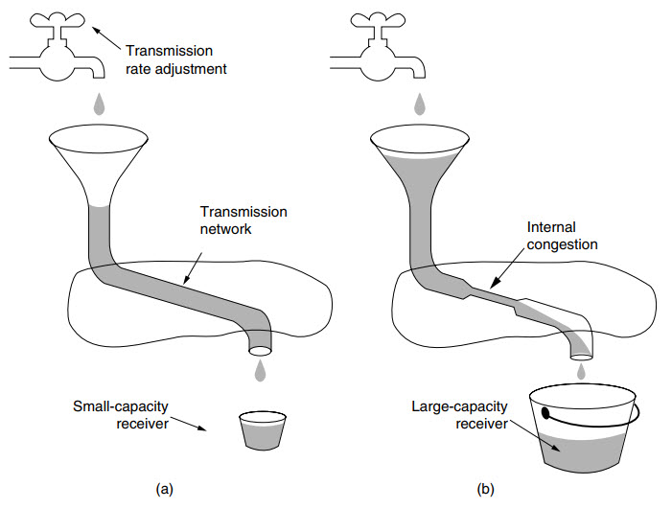
Transmission Control Protocol [TCP] (Cntd.)
Regulating the Sending Rate
Figure: (a) A fast network feeding a low-capacity receiver. (b) A slow network feeding a high-capacity receiver.

Slide 88
Transmission Control Protocol [TCP] (Cntd.)
Regulating the Sending Rate:
There are 2 types of Regulating the Sending Rate algorithms:
Leaky Bucket
Token Bucket
A leaky bucket algorithm shapes bursty traffic into fixed-rate traffic by averaging the data rate.
It may drop the packets if the bucket is full.

Slide 89
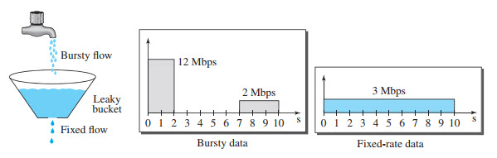
Leaky Bucket
Assume that the network has committed a bandwidth of 3 Mbps for a host.
The use of the leaky bucket shapes the input traffic to make it conform to this commitment.
In Figure the host sends a burst of data at a rate of 12 Mbps for 2 s, for a total of 24 Mbits of data.
The host is silent for 5 s and then sends data at a rate of 2 Mbps for 3 s, for a total of 6 Mbits of data.
In all, the host has sent 30 Mbits of data in 10 s.
The leaky bucket smooths the traffic by sending out data at a rate of 3 Mbps during the same 10 s. Without the leaky bucket, the beginning burst may have hurt the network by consuming more bandwidth than is set aside for this host.
Figure: Leaky bucket.

Slide 90
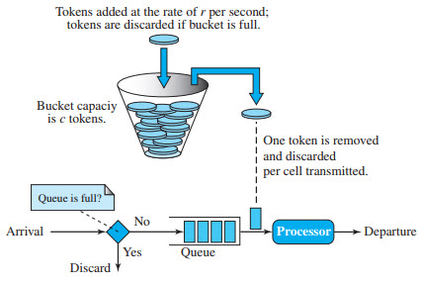
Token Bucket
Regulating the Sending Rate (Cntd.): Token Bucket
The token bucket allows bursty traffic at a regulated maximum rate.
Step 1 − In regular intervals tokens are thrown into the bucket f.
Step 2 − The bucket has a maximum capacity c.
Step 3 − If the packet is ready, then a token is removed from the bucket, and the packet is sent.
Step 4 − Suppose, if there is no token in the bucket, the packet cannot be sent.
Figure: Token bucket.

Slide 91
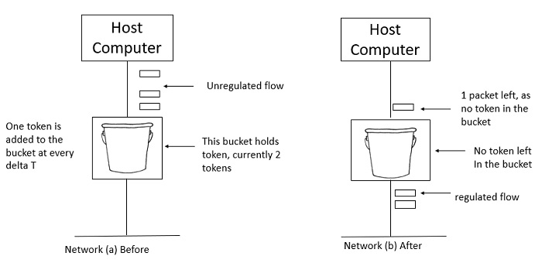
Token Bucket
Regulating the Sending Rate (Cntd.): Token Bucket
In figure (a) the bucket holds two tokens, and three packets are waiting to be sent out of the interface.
In Figure (b) two packets have been sent out by consuming two tokens, and 1 packet is still left.
Figure: Token bucket.

Slide 92
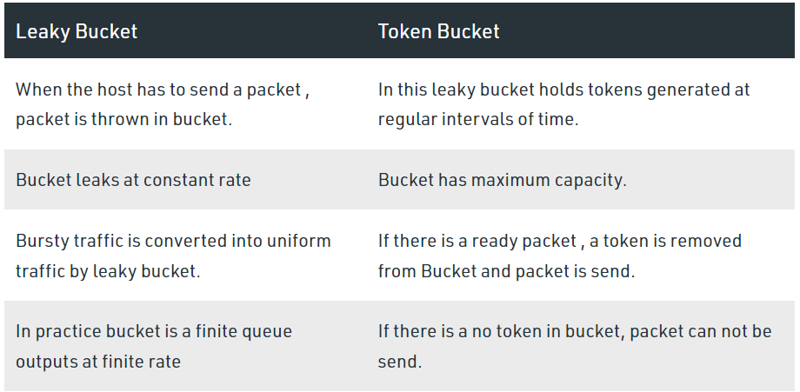
Transmission Control Protocol [TCP] (Cntd.)

Slide 93
Quality of Service [QoS]
Another way of looking at the transport layer is to regard its primary function as Enhancing the QoS (Quality of Service) provided by the network layer.
If the network service is poor, the transport layer has to bridge the gap between what the application users want and what the network layer provides.
The transport service may allow the user to specify preferred, acceptable, and minimum values for various service parameters at the time a connection is setup.

Slide 94
Quality of Service [QoS] (Cntd.)
QoS Parameters:
The connection establishment delay: The time difference between the instant at which a transport connection is requested and the instant at which it is confirmed is called as connection establishment delay
The connection establishment failure probability: It is the probability that connection is not established even after the maximum connection establishment delay. This problem will occur due to network congestion, lack of table space or some other problems.
Throughput: This parameter describes the average data transfer rate at the network transport level.
Transit delay: The delay refers to the time required to transmit a packet or a group of packets from the transmit end to the receive end.

Slide 95
Quality of Service [QoS] (Cntd.)
QoS Parameters
Residual error ratio: Residual error ratio (RER) is the ratio of total incorrect, lost and duplicated Data units to the total Data units transferred between users during a period of time.
Protection: Protection is the extent to which a provider attempts to prevent unauthorized monitoring or manipulation of user-originated information.
Priority: Quality of Service (QoS) prioritizes network traffic and manages available bandwidth so that the most important traffic goes first.
Resilience: Resilience is meaningful in connection mode only, and represents the probability of either: Data Link Service provider-initiated disconnects or Data Link Service provider-initiated resets during a time interval of 10,000 seconds on a connection.

Slide 96
NPTEL Video Lecture Links on Transport Layer
https://www.youtube.com/watch?v=8-3CSAkscYU
https://www.youtube.com/watch?v=fBPDLGwfSUM
https://www.youtube.com/watch?v=c8Wv3b7f9XY
https://www.youtube.com/watch?v=qclg6FY-FGM
https://www.youtube.com/watch?v=VUdfS70puWI
https://www.youtube.com/watch?v=bKHRbqwkMkg
https://www.youtube.com/watch?v=b-nCA0tZU-0
https://www.youtube.com/watch?v=EqzDTO9tdqs
https://www.youtube.com/watch?v=5ex1s4lURto
https://www.youtube.com/watch?v=xS202cWCc2Q
https://www.youtube.com/watch?v=8NxJGHXDOGc
https://www.youtube.com/watch?v=SHO9eeWxPxY
https://www.youtube.com/watch?v=f1y25BfOH9I
https://www.youtube.com/watch?v=x7obJLN7FcQ
https://www.youtube.com/watch?v=JExfKvUgrtI

Slide 97
NPTEL Web Links on Transport Layer
https://nptel.ac.in/courses/106106091/36
https://nptel.ac.in/courses/106106091/37
https://nptel.ac.in/courses/106106091/38
https://nptel.ac.in/courses/106106091/39
https://nptel.ac.in/courses/106105080/32

Slide 98
References
Text Books:
Behrouz A. Forouzan, ‘Data Communications and Networking’, 5th Edition, McGraw-Hill Publishing Company, ISBN 978-0-07-337622-6
Tanenbaum A. S., ‘Computer Networks’, Pearson Education , 5th Edition, ISBN-978-0-13-212695-3
Reference Books:
James F. Kurose and Keith W Ross ‘Computer Networking, A Top-Down Approach’, 5th Edition, Pearson Education, ISBN- 978-81-317-9054-0
W. Richard Stevens, Unix Network Programming, The Sockets Networking API, Vol 1, 3rd Edition, PHI Learning Pvt. Ltd.
Supplementary Reading:
William Stallings, ‘Data and Computer Communications’, 6th Edition, Prentice Hall of India Pvt.
Web Resources:
https://nptel.ac.in/courses/106/105/106105080/
https://nptel.ac.in/courses/106/106/106106091/
Web links:
https://nptel.ac.in/courses/106/105/106105081/
https://nptel.ac.in/courses/106/105/106105183/
https://ocw.mit.edu/courses/electrical-engineering-and-computer-science/6-829-computer-networks-fall-2002/index.htm
MOOCs:
https://www.coursera.org/learn/computer-networking
https://www.edx.org/course/introduction-to-networking?index=product&queryID=0befdc538866babf2facfdc2dce06204&position=1

Slide 99
Thank You
Any Questions

